Slide 1
Telecom churn prediction
Final Hackathon
Vignesh V
batch : 108b

Slide 2
contents
Objective
Problem Statement
Data Exploration
Data Visualization
Machine Learning Model
Observations
Deployment

Slide 3
objective
Telecommunication providers lose close to $65 million a month from customer churn.
This is often referred to as Customer Churn in Telecom. Telecommunication providers that focus on quality service, lower-cost subscription plans, availability of content and features whilst creating positive customer service experiences have high chances of customer retention.
In this data science project, you will build a logistic regression machine learning model to understand the correlation between the different variables in the dataset and customer churn.

Slide 4
Project objective
To predict Customer Churn
Data analysis
Building an Machine Learning Model and evaluate the accuracy
Providing an insight
Deploying our model in docker

Slide 5
data
customerID: A unique identifier for each customer.
gender: The gender of the customer.
SeniorCitizen: Whether the customer is a senior citizen or not.
Partner: Whether the customer has a partner or not.
Dependents: Whether the customer has any dependents (e.g. children) or not.
tenure: The length of time (in months) that the customer has been with the company.
PhoneService: Whether the customer has phone service or not. MultipleLines: Whether the customer has multiple phone lines or not.
InternetService: The type of internet service the customer has.
OnlineSecurity: Whether the customer has online security or not.

Slide 6
OnlineBackup: Whether the customer has online backup or not.
DeviceProtection: Whether the customer has device protection or not.
TechSupport: Whether the customer has tech support or not.
StreamingTV: Whether the customer has streaming TV service or not.
StreamingMovies: Whether the customer has streaming movie service or not.
Contract: The type of contract the customer has with the company. PaperlessBilling: Whether the customer has paperless billing or not.
PaymentMethod: The customer's payment method.
MonthlyCharges: The amount the customer is charged per month.
TotalCharges: The total amount the customer has been charged since joining the company.
Churn: Whether the customer has churned (i.e. stopped using the company's services) or not.
The dataset contain 7043 rows and 21 columns

Slide 7
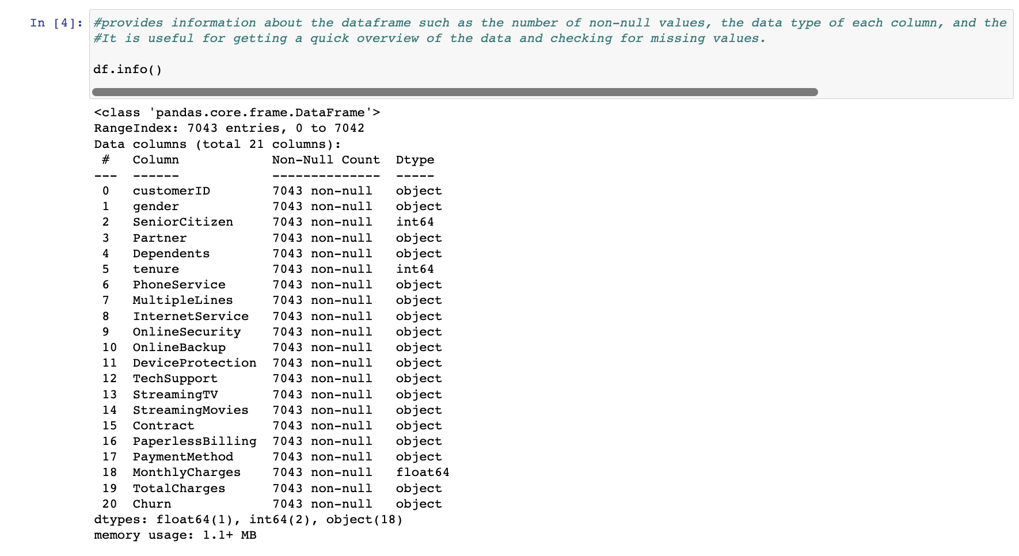

Slide 8
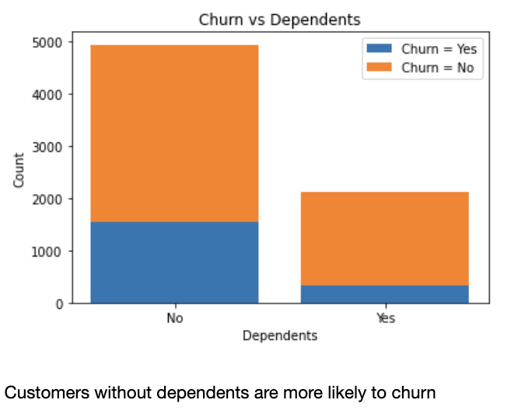

Slide 9
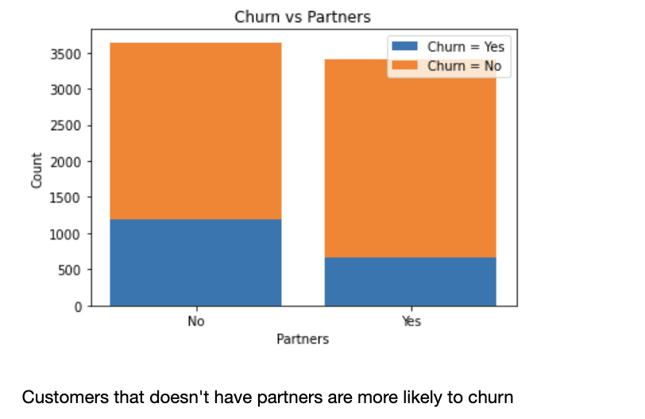

Slide 10
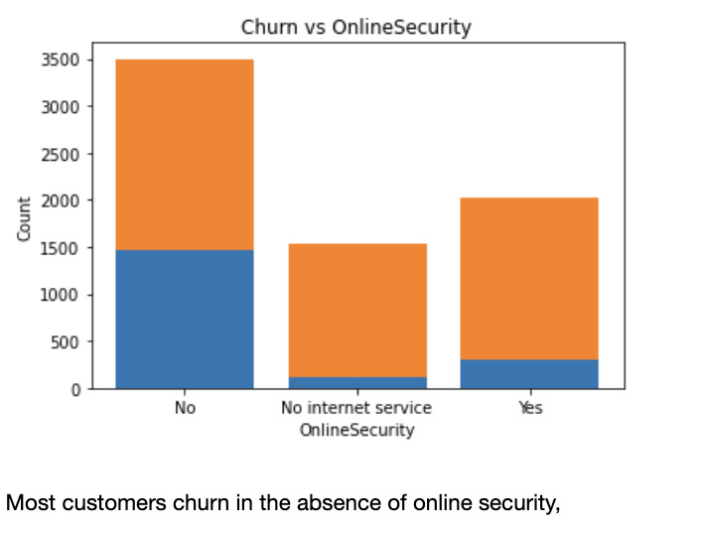

Slide 11
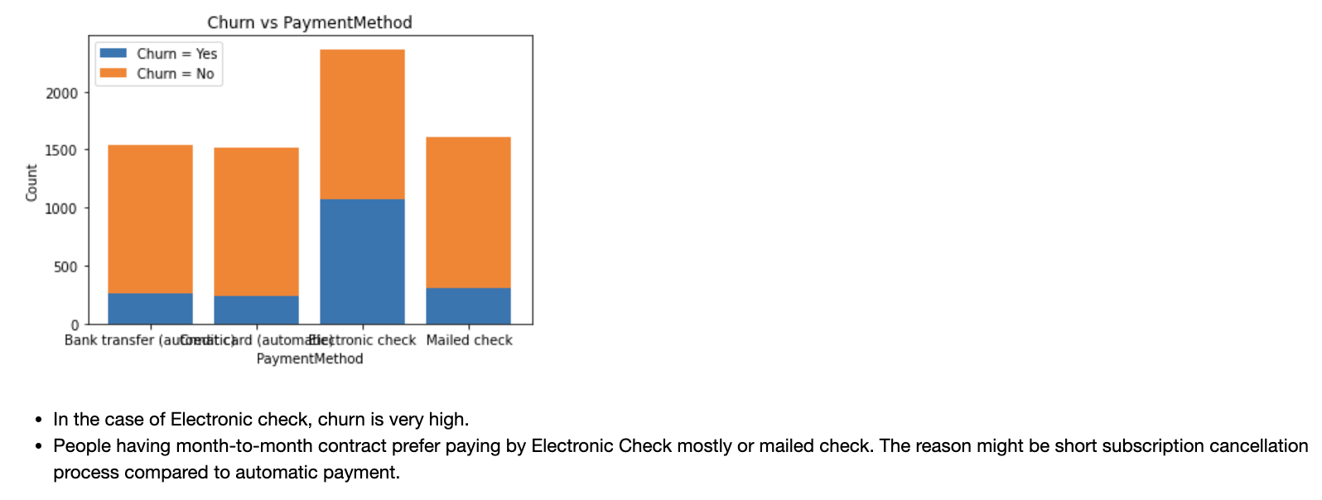

Slide 12
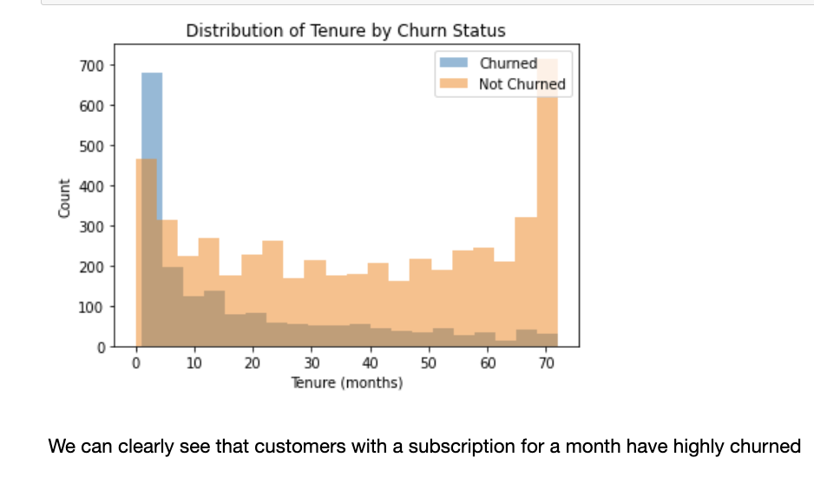

Slide 13
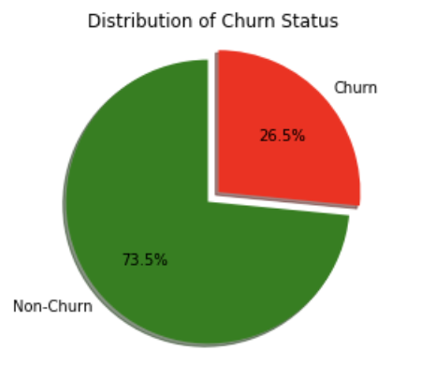

Slide 14
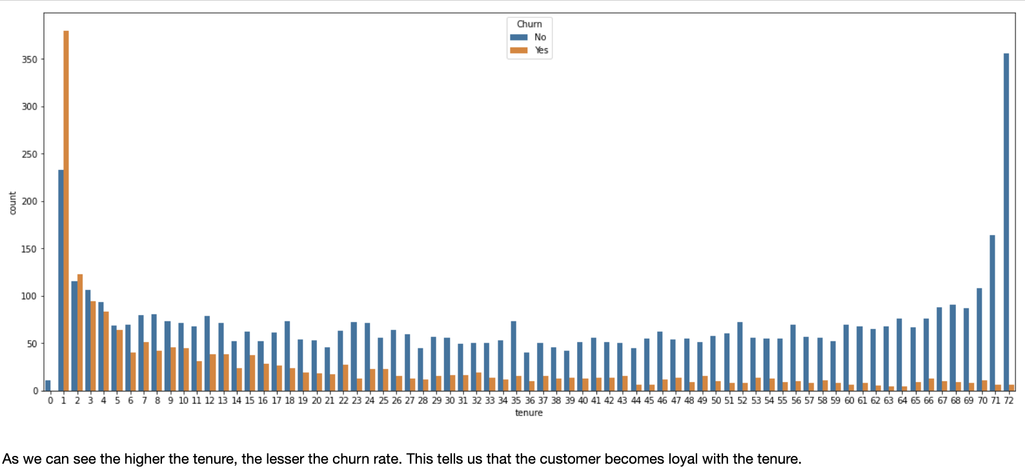

Slide 15
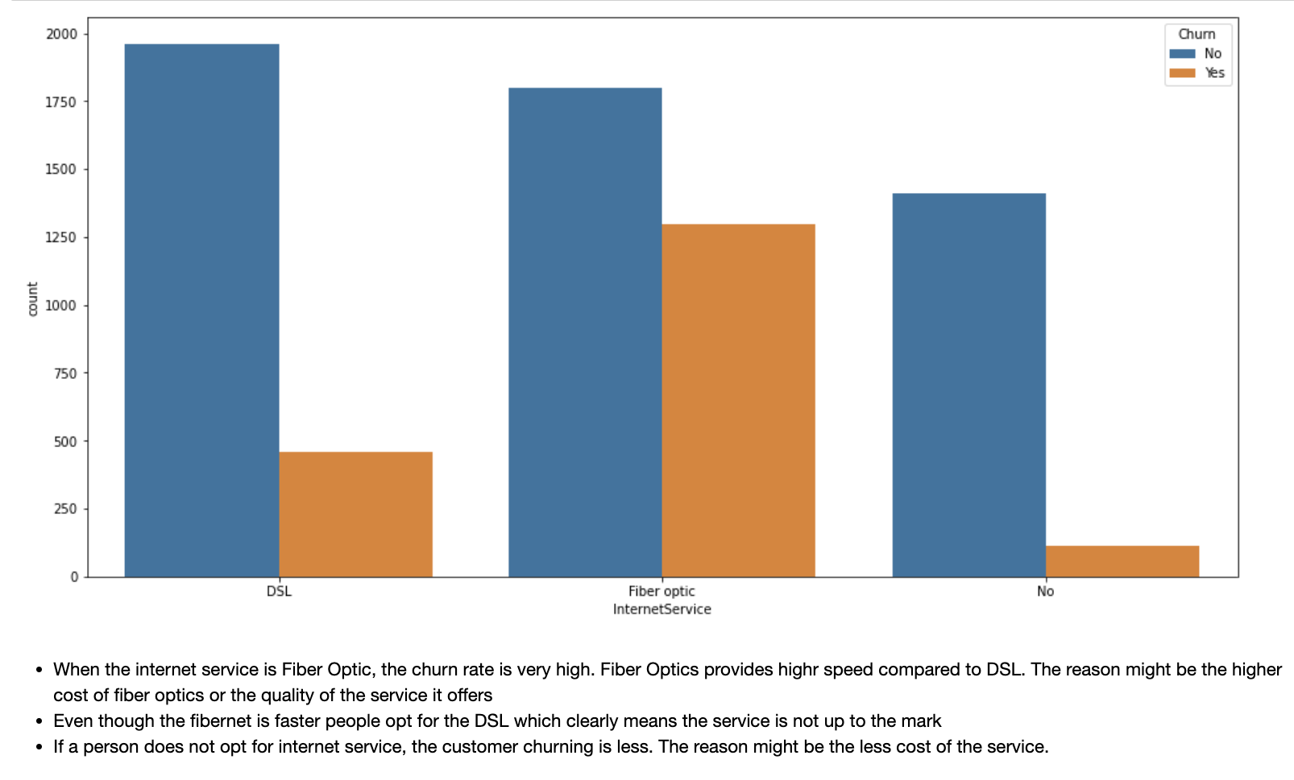

Slide 16
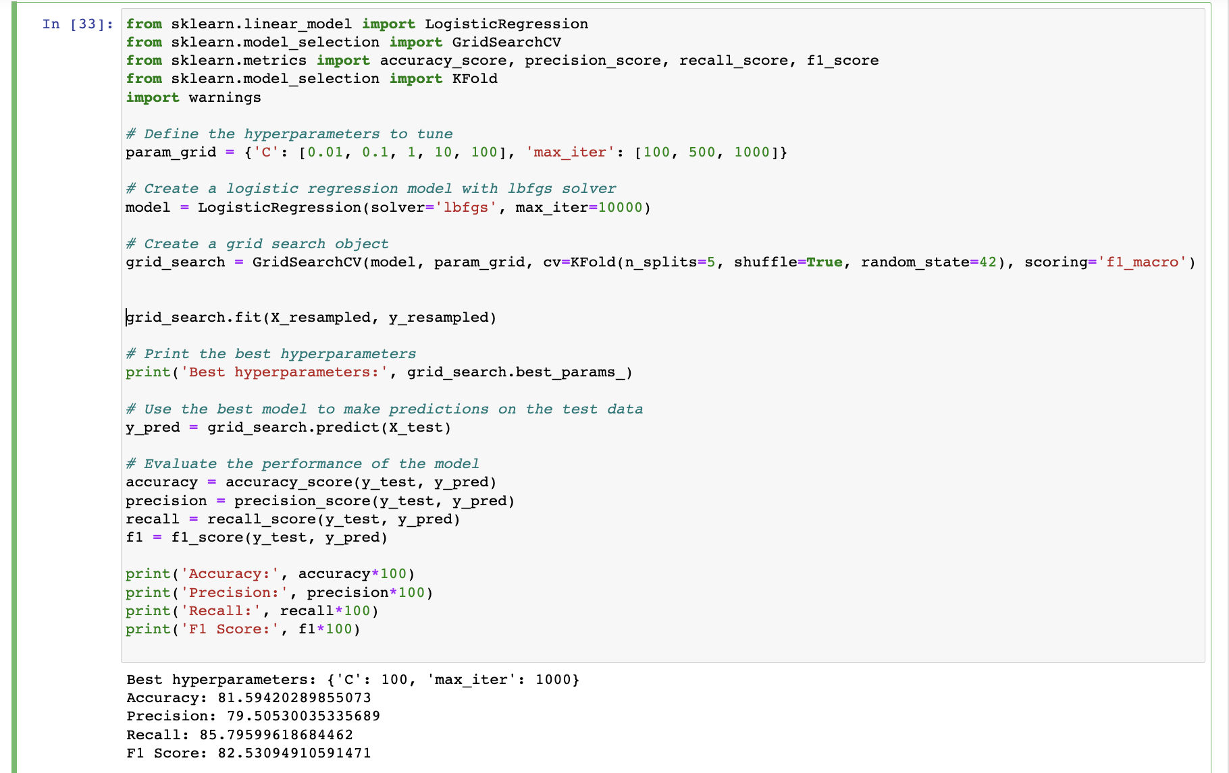
Model building

Slide 17
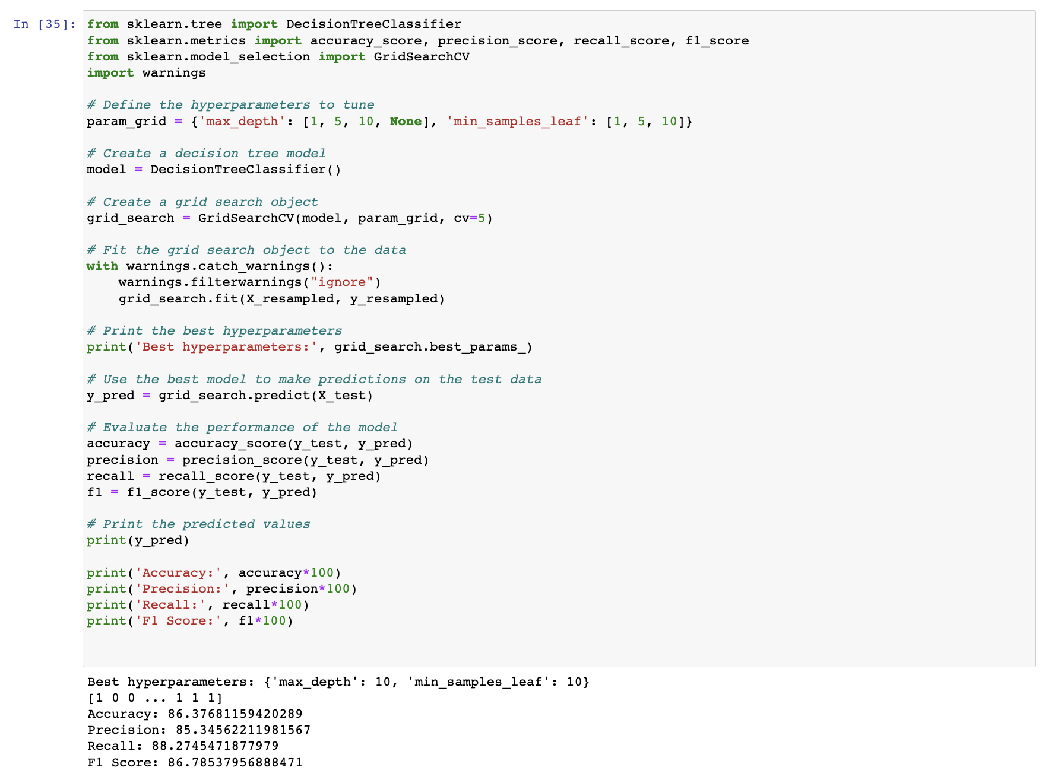

Slide 18
How to reduce churn
Lean on your best customers
Have a good tech support
Keep the prices competitive
Improve the fibernet service

Slide 19
streamlit
Streamlit is an open-source Python library used for building and deploying interactive web applications for data science and machine learning projects.
It allows developers and data scientists to quickly create interactive dashboards and data visualizations, without requiring expertise in web development.
Streamlit is gaining popularity among data scientists and machine learning practitioners due to its simplicity, ease of use, and flexibility.

Slide 20
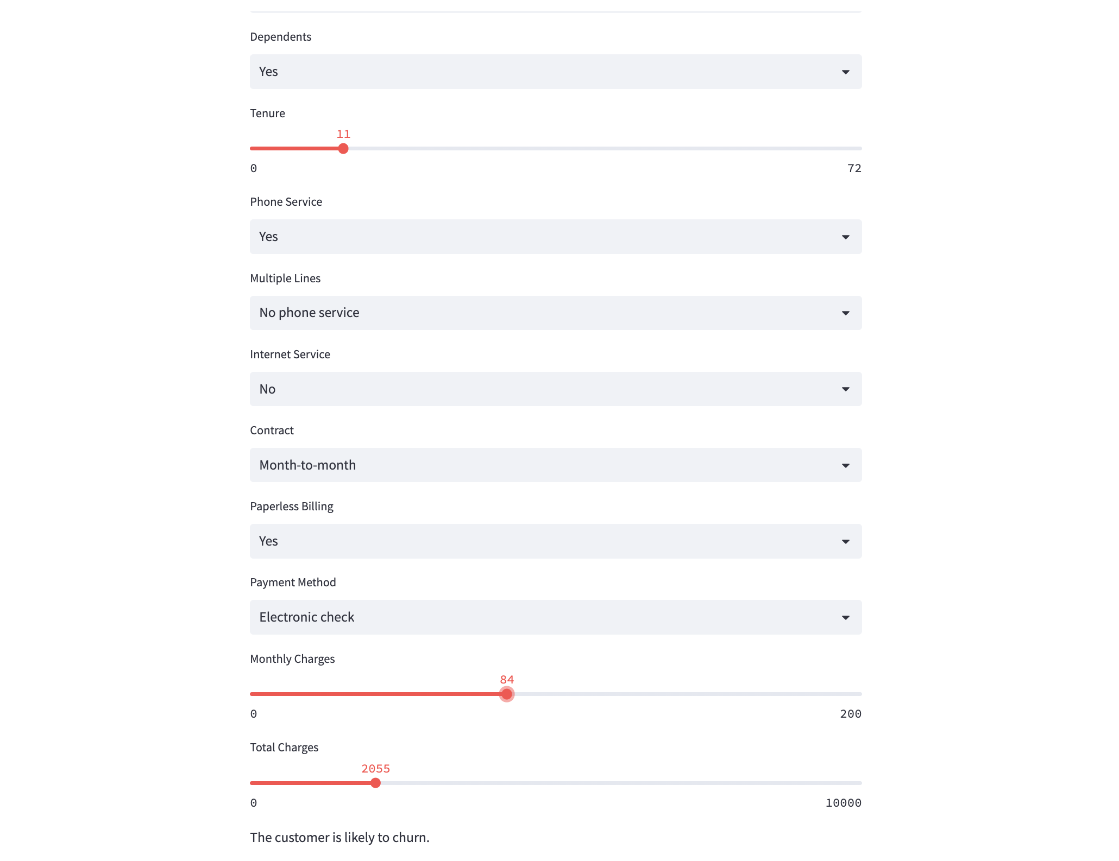
Streamlit interface

Slide 21
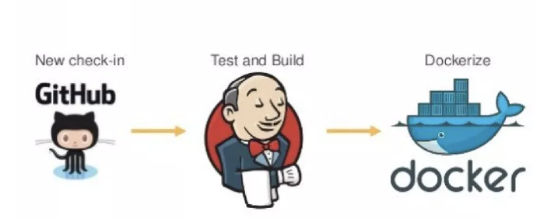
Deployment

Slide 22
Train your machine learning model: Before you can deploy your model, you need to train it using your preferred framework or library such as Scikit-learn, TensorFlow, PyTorch, etc. Once you have trained your model, save it in a format that can be loaded by your application, such as a pickle file or a TensorFlow SavedModel.
Containerize your application using Docker: Create a Dockerfile that defines the environment and dependencies for your application. This file will be used by Docker to build the container image for your application.
Set up Jenkins: Install Jenkins on your server, if it is not already installed. Create a new Jenkins job that will build and deploy your application.

Slide 23
Configure the Jenkins pipeline: In the Jenkins pipeline, specify the steps to build the Docker image, push it to a registry, and deploy the container to your server. You can use the Jenkins Docker Plugin to automate the Docker build and push steps.
Use Streamlit to create a user interface for your model: Streamlit is a Python library that allows you to easily create web applications for your machine learning models. Use Streamlit to create a user interface for your model that allows users to interact with it.
Deploy the application: Once you have built and deployed the Docker container, you can start the application by running the container on your server. Users can then access the Streamlit user interface to interact with your machine learning model.

Slide 24
jenkins
Jenkins allows developers to automate the build and deployment process for their applications, which can save time and reduce errors that can occur during manual processes.
It provides a flexible and extensible platform that can be customized to meet the needs of different software development teams.

Slide 25
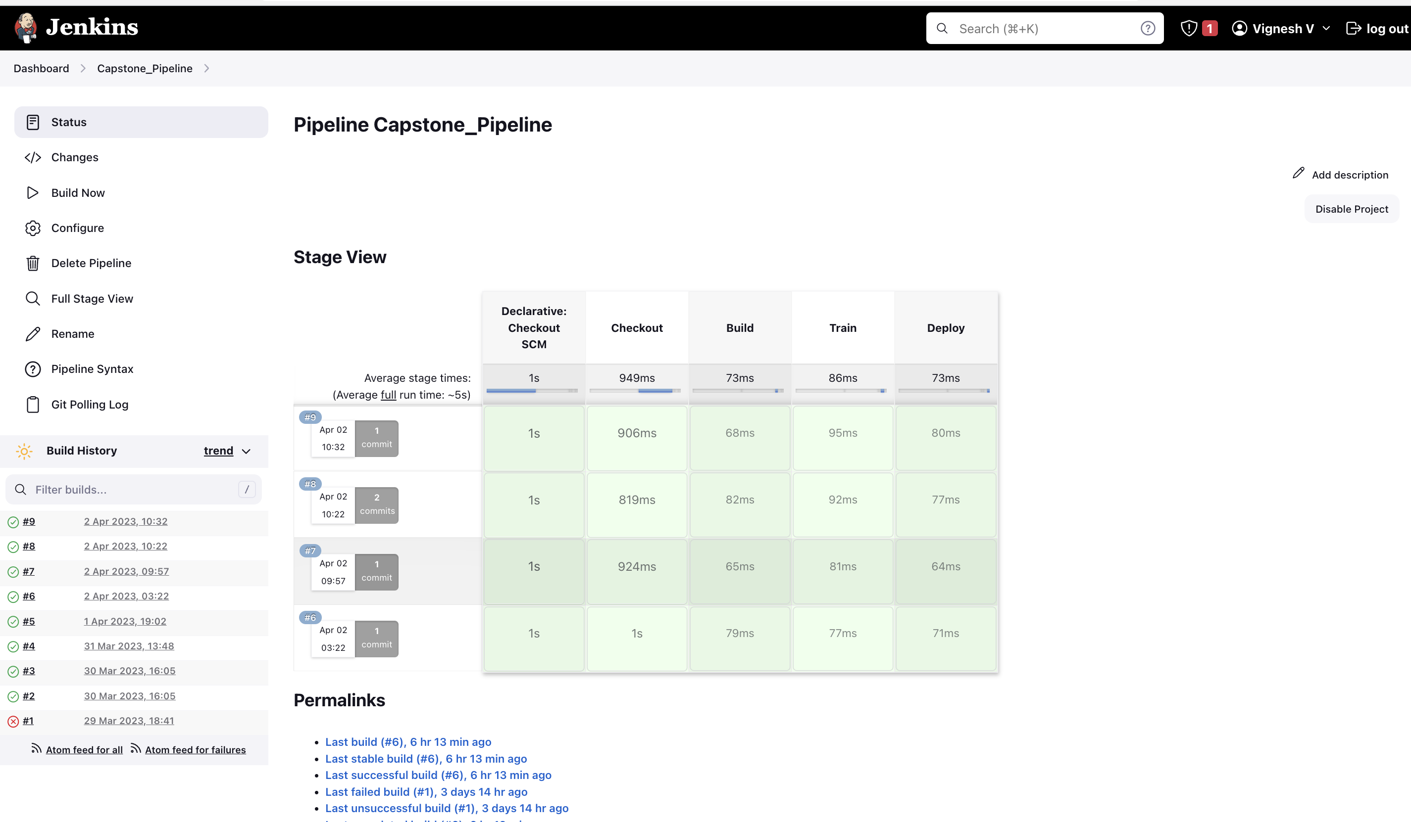

Slide 26
docker
Docker provides a container runtime and a set of tools that allow developers to create, deploy, and manage containers.
It uses a client-server architecture, where the Docker client communicates with the Docker daemon, which is responsible for managing the containers.
Docker containers provide a consistent and reproducible environment for running applications, which can help reduce the risk of compatibility issues and deployment errors.
Containers also allow developers to run multiple instances of an application on a single host, which can help increase resource utilization and reduce infrastructure costs.

Slide 27
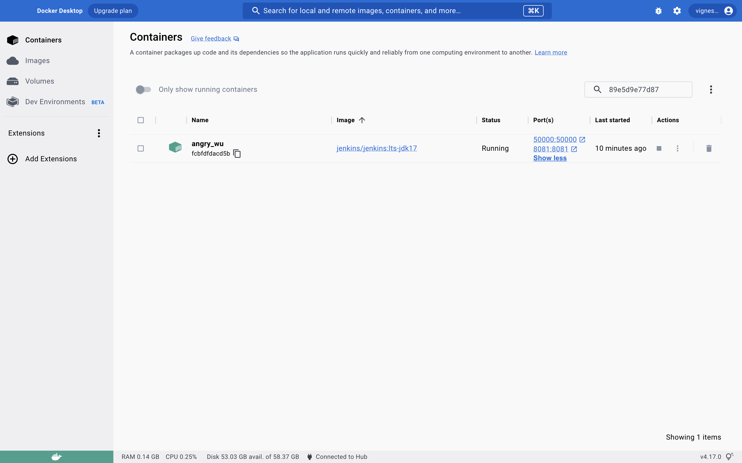

Slide 28
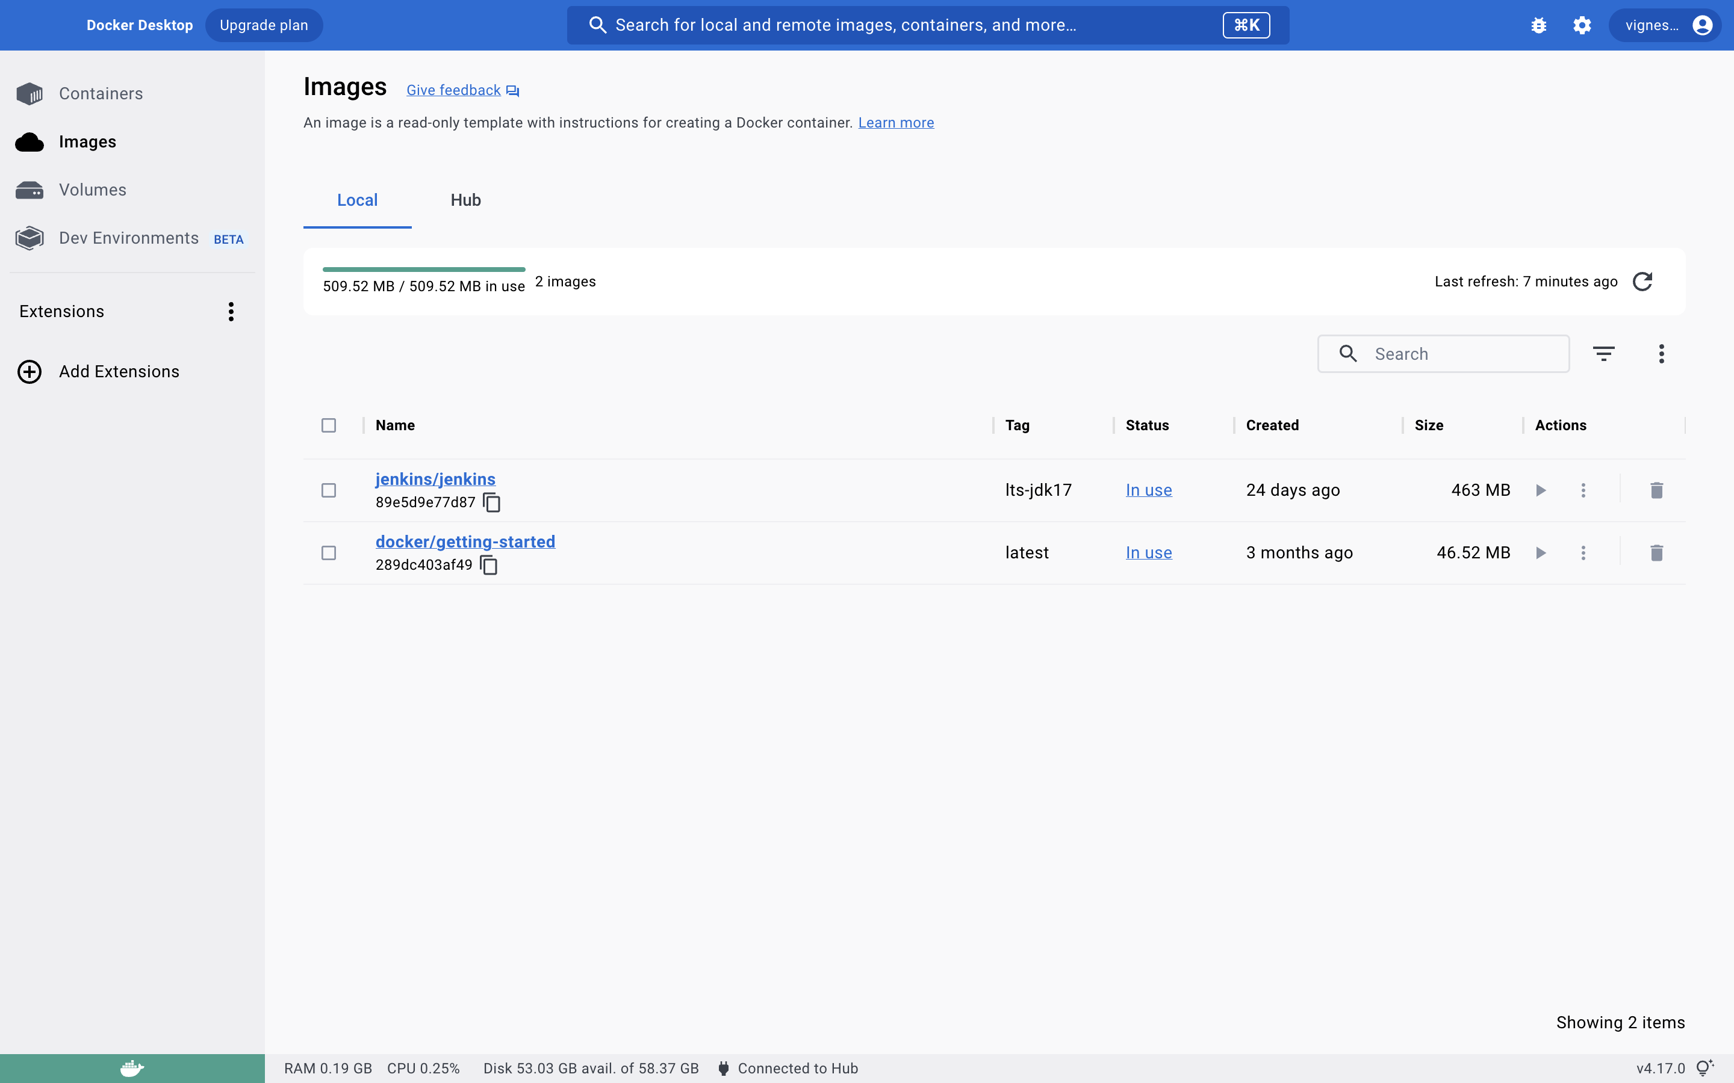

Slide 29
Thank you

